Slide 1

Module 1
Information Technology
English Foundation for Info Tech

Slide 2
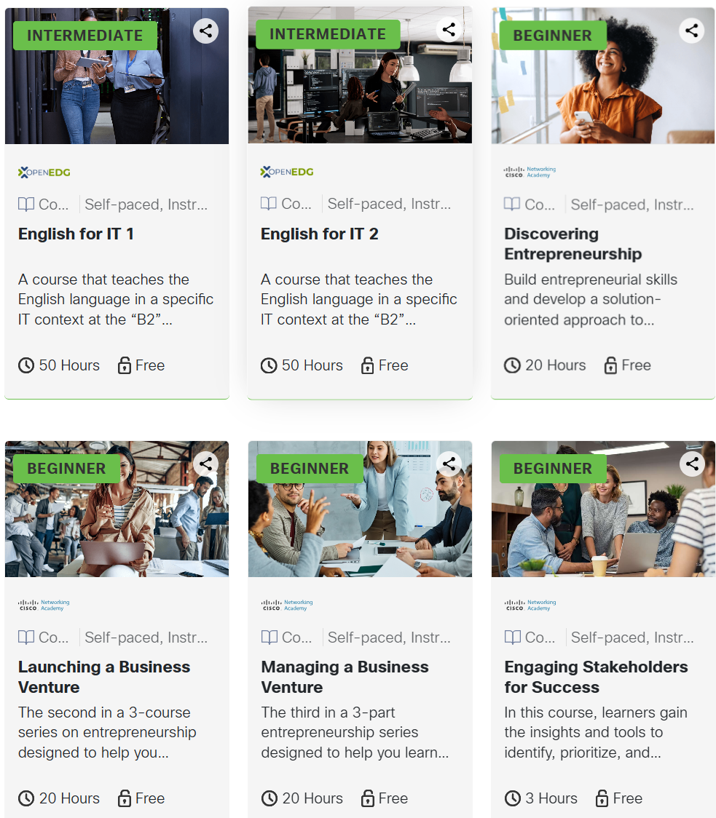
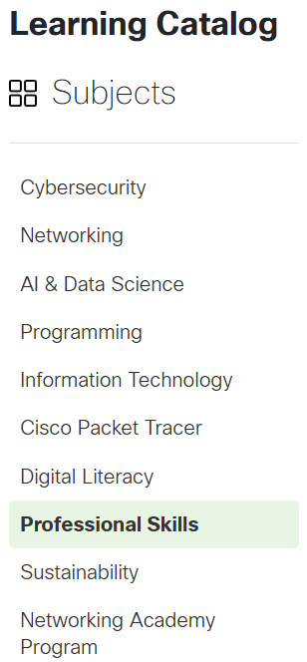


Learning Catalog

Slide 3
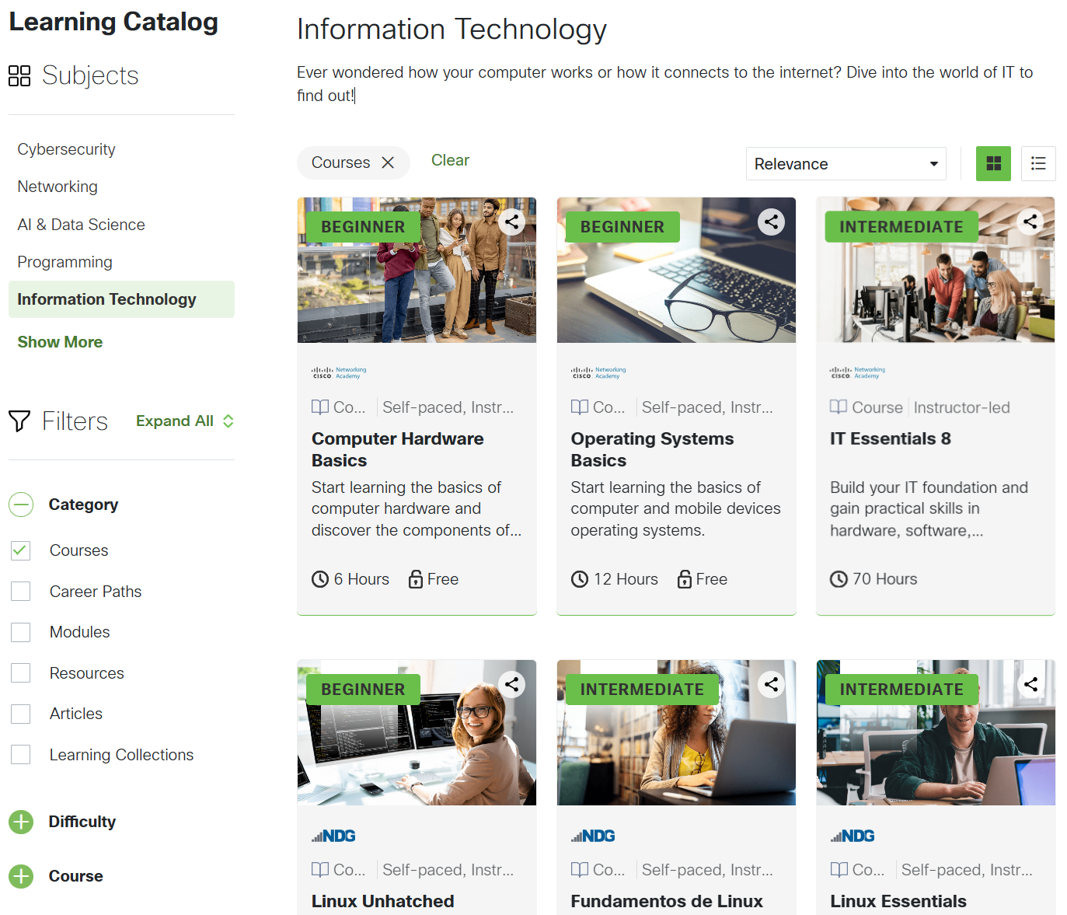





Slide 4
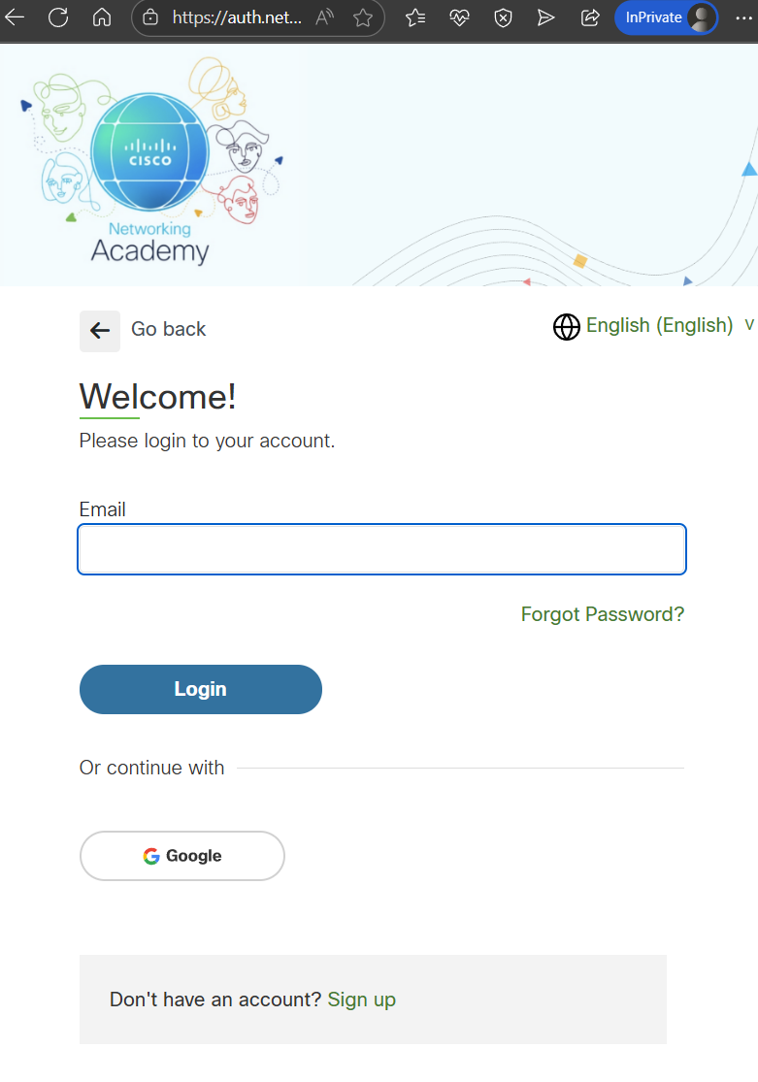

Slide 5
Computer Hardware Basics

Slide 6
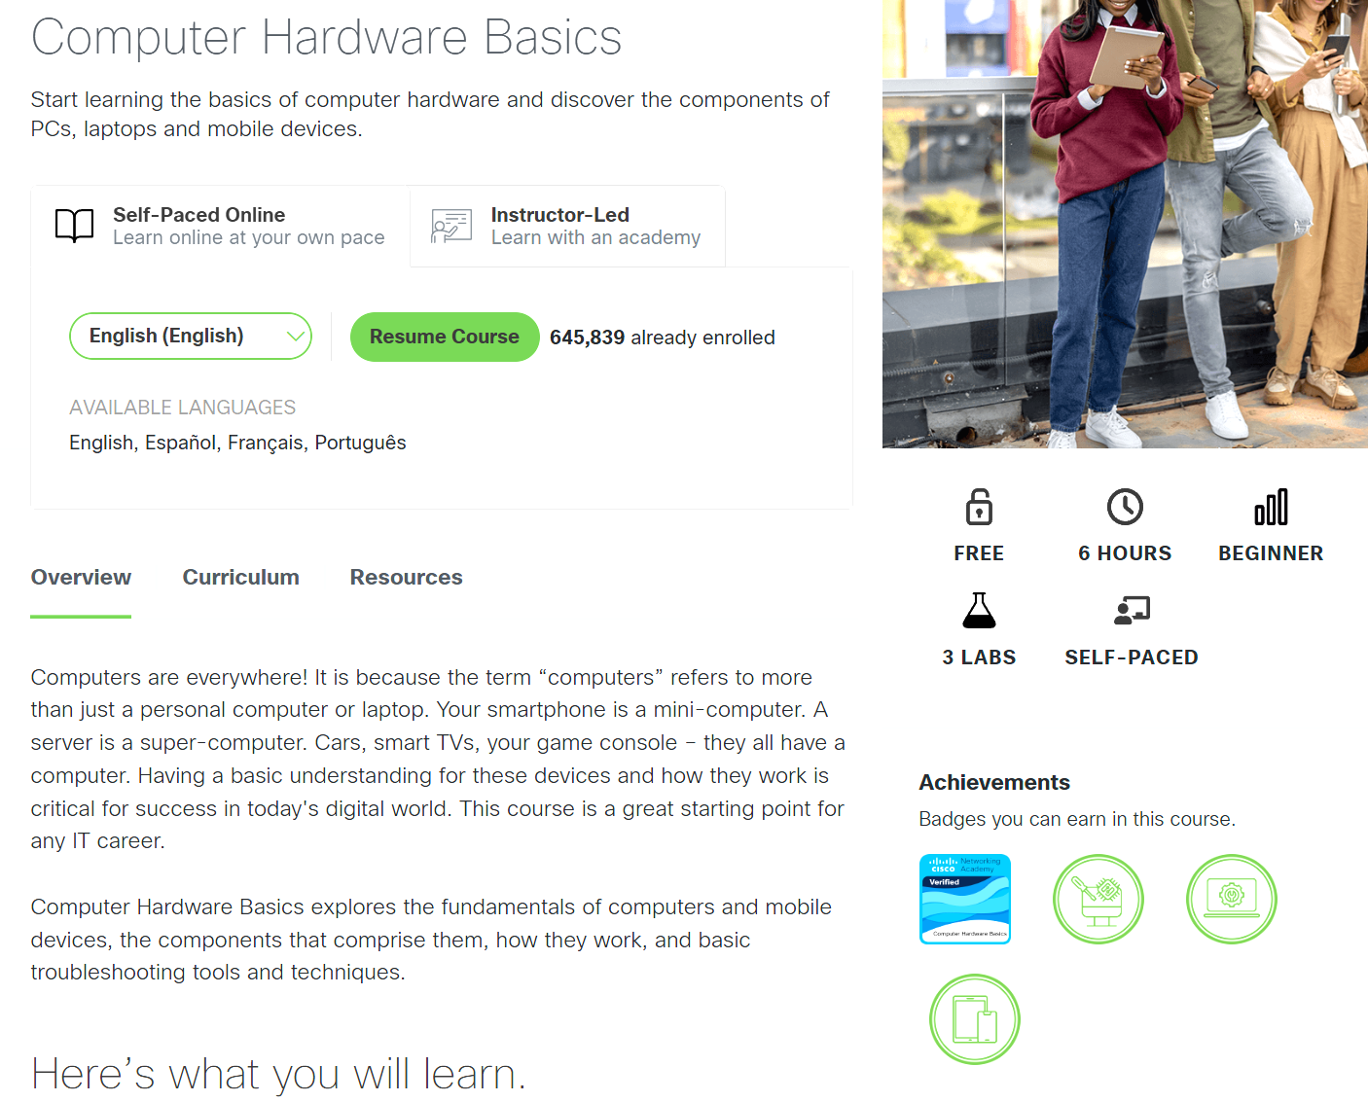




Computer Hardware
Basics

Slide 7
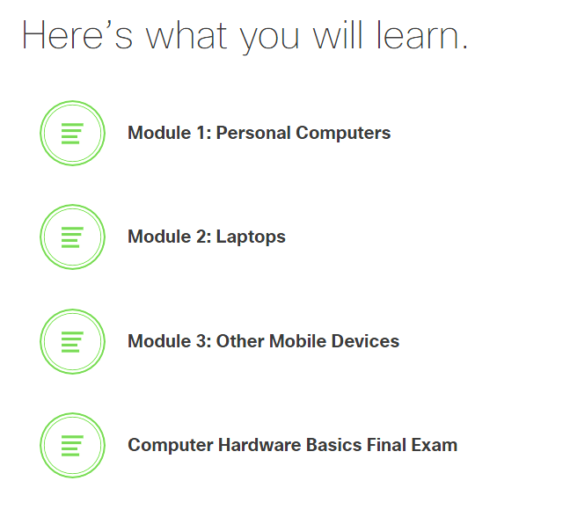
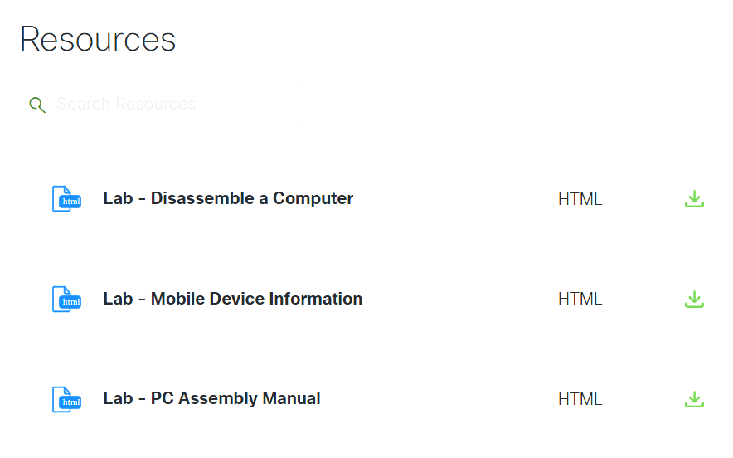



We cover only module 1 in class

